Slide 1
Functions

Slide 2
Outline
In this lesson, we will:
Review mathematical functions
Look at the use of functions in C++
Describe function declarations
Their relation to the domain and range
Parameters and arguments
Example: a fast sine function
Side effects
Functions with no return values
The void keyword
A second-last look at understanding int main()

Slide 3
Using functions
In secondary school mathematics courses, you were introduced to numerous functions:
The trigonometric functions
Possibly including hyperbolic functions and the inverses of these
The exponential and logarithmic functions
The absolute value
The square root
The ceiling and floor functions
The greatest common divisor and least common multiple functions
The maximum or minimum of two arguments

Slide 4
Using functions
All of these have some properties in common:
Each function requires a fixed number of arguments that must be of a certain type, either integers or real numbers
Given the same arguments, the functions return the same value
Many of these functions are implemented in the cmath library

Slide 5
Using functions
#include <iostream>
#include <cmath>
int main();
int main() {
std::cout << "sin(3.2) = " << std::sin( 3.2 ) << std::endl;
std::cout << "tan(3.2) = " << std::tan( 3.2 ) << std::endl;
std::cout << "csc(3.2) = " << (1.0/std::sin( 3.2 )) << std::endl;
std::cout << "cot(3.2) = " << (1.0/std::tan( 3.2 )) << std::endl;
std::cout << "sinh(3.2) = " << std::sinh( 3.2 ) << std::endl;
std::cout << "tanh(3.2) = " << std::tanh( 3.2 ) << std::endl;
std::cout << "acos(0.2) = " << std::acos( 0.2 ) << std::endl;
std::cout << "asech(0.2) = " << std::acosh( 1.0/0.2 ) << std::endl;
return 0;
}
Must use std::sin( 3.2 )
Mathematicians sometimes use sinθ or sin2θ
Output:
sin(3.2) = -0.0583741
tan(3.2) = 0.0584739
csc(3.2) = -17.1309
cot(3.2) = 17.1017
sinh(3.2) = 12.2459
tanh(3.2) = 0.996682
acos(0.2) = 1.36944
asech(0.2) = 2.29243

Slide 6
Using functions
In each case, the argument is of type double
A double-precision floating-point number
The output is a floating-point number
The compiler knows this, so while you compile
std::cout << std::sin(32);
the compiler knows that:
The integer 32 must be converted to a floating-point number
The above statement must call the routines for printing a floating-point number

Slide 7
Function declarations
How does the compiler know this about the sine function?
We must declare the sine function in a manner similar to main()
int main();
This says main() does not have any parameters and it returns an integer
For the sine function, we know it has a domain and range:
name
domain
range

Slide 8
Function declarations
Suppose we wanted to define a polynomial p such that when it is called with an argument x, it returns the value
To this point, we have seen that int represents that the return type is an integer
Polynomials, however, are defined for all real numbers
Floating point numbers in C++
A type for floating-point numbers is double
Short for double-precision floating-point numbers

Slide 9
Function parameters
Additionally, the polynomial
requires a variable or parameter x
x can take on any real value, so we call it a variable
The result of the polynomial depends on x, so we say x is a parameter
The function declaration is
double p( double x );
This function:
Has the identifier p
Takes a variable parameter x that must be a floating-point number
Returns a floating-point number

Slide 10
Function definitions
The function int main() simply returned 0
To evaluate
we must perform an arithmetic calculation
The function definition would be:
double p( double x ) {
return 5.0*x*x - 3.0*x - 9.0;
}
Using 5.0 emphasizes to the reader
that it is a floating-point number.

Slide 11
Parameters and arguments
In the function definition, variable x is referred to as a parameter:
double p( double x ) {
return 5.0*x*x – 3.0*x – 9.0;
}
If you call this function with a value that is to be used in the function, that value is said to be the argument:
int main() {
std::cout << "p(4.2) = " << p( 4.2 )
<< std::endl;
return 0;
}
the parameter x
the argument 4.2

Slide 12
Another example
Suppose we wanted to define a bivariate polynomial q such that when it is called with arguments x and y, it returns the value
The function declaration and definitions could be
double q( double x, double y );
double q( double x, double y ) {
return x*x - 2*x*y + y*y;
}
Alternate function definition:
double q( double x, double y ) {
return (x - y)*(x - y);
}

Slide 13
Another example
Question: which implementation is faster?
double q( double x, double y ) { double q( double x, double y ) {
return x*x - 2*x*y + y*y; return (x - y)*(x - y);
} }
These require:
Four multiplications and two addition/subtractions
One multiplication and two addition/subtractions (or just one?)

Slide 14
The greatest common divisor
The greatest common divisor (gcd) is another function you saw in secondary school
E.g., gcd(42, 70) = 14
It depends on two integer parameters and returns an integer
Its function declaration would be
unsigned int gcd( int m, int n );
name
domain
range
Cartesian product of two sets of integers
natural numbers

Slide 15
Other examples
Some functions you saw in secondary school were represented graphically:
Exponents were written as superscripts:
The square root was written with a radical symbol:
n^{th} roots had even further decorations:
The absolute value was two bars:
In C++, we are restricted to functions and identifiers:
double pow( double x, double y );
double sqrt( double x );
double sqrt( double x, int n );
double abs( double x );

Slide 16
Other examples
The standard mathematics library has some of these:
double std::pow( double x, double y );
double std::sqrt( double x );
double std::abs( double x );
For the n^{th} root, the user is expected to use pow:

Slide 17
A fast sine function
Engineers are always concerned with the trade-off between precision and speed (run times)
The std::sin(…) function gives 16-decimal digits of precision
It’s also relatively slow
Suppose we know we only need to calculate sin(x) for
Can we find a good enough approximation of sin(x) restricted to this interval?

Slide 18
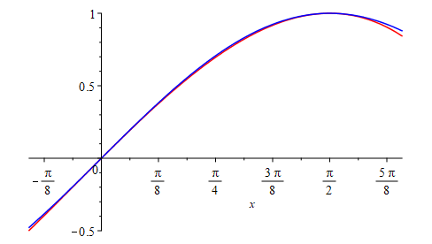
A fast sine function
Without proof, the polynomial
satisfies:
The value of these coefficients are:

Slide 19
A fast sine function
We can thus implement:
as
double fast_sin( double x );
double fast_sin( double x ) {
return -0.11073981636184074*x*x*x
- 0.057385341027109429*x*x + x;
}

Slide 20
A faster sine function
We can even reduce the number of multiplications by one:
double fast_sin( double x );
double fast_sin( double x ) {
return ((-0.11073981636184074*x
- 0.057385341027109429)*x + 1.0)*x;
}
as

Slide 21
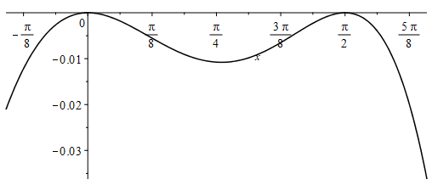
A fast sine function
Comparing sin(x) and our approximation:
sin(x)
Note that
The absolute error is less than 0.011 on [0, π/2]

Slide 22
Comments
Functions must be commented to ensure other programmers know what is expected
Comments must be in English, not pseudocode or obvious
// Function declarations
double fast_sin( double x );
// Function definitions
/* double fast_sin( double x )
*
* A function that quickly calculates sin(x) for values
* that satisfy 0 <= x <= pi/2
*/
double fast_sin( double x ) {
return ((-0.11073981636184074*x
- 0.057385341027109429)*x + 1.0)*x;
}
Line comments:
– from // to the end of the line
Block comments:
– from /* to */

Slide 23
Other functions
Most functions require more than simple calculations
Most require decision making processes:
Others require a repetitive algorithm until some condition is met
E.g., finding the gcd, calculating the square root
In some cases, some functions can be defined in terms of others
E.g., the least common multiple:

Slide 24
Side effects
In mathematics, the result of a function depends entirely on the arguments
Anything else a function does is called a side-effect
The side-effect of the int main() function is to print “Hello world!” to the console output
A side effect of this function is to record to a log file what was being calculated
double fast_sin( double x );
double fast_sin( double x ) {
std::clog << "Calculating p(" << x << ")" << std::endl;
return ((-0.11073981636184074*x
- 0.057385341027109429)*x + 1.0)*x;
}

Slide 25
No return value
Some functions have no return value:
Such functions are identified by describing the return type as void:
void print_my_name();
void print_my_name() {
std::cout << "Zaphod Beeblebrox" << std::endl;
return;
}
No return value
Just return, don’t return any value
You can even leave this off

Slide 26
The keyword void
The identifier void is a keyword in C++
Problem: every identifier that is used as a keyword restricts the identifiers that may be used by the programmers
Problem: too many keywords frustrate programmers
Solution: use the same keyword to mean different things in different contexts…
In English, homographic homonyms are a source of puns:
“He picked up his saw.”
“That was something she saw.”
“Did you hear about the miracle of the carpenter who was cured of blindness? He picked up his hammer and saw.”
We will see void used in two different contexts—get used to it now

Slide 27
Why not void main() ?
The function declaration for main() has it returning an int
Executing programs can cause other programs to execute
When a program exits, the value returned by main() could be used by the program that launched it
The value 0 is generally used to indicate “a successful execution”
If something went wrong, the program could return a non-zero integer that can be used to flag what the issue was
For this course, main() will always return 0

Slide 28
Arithmetic expression
We have already described how an arithmetic expression can be any sum, difference, product or ratio of either integers or floating-point numbers
We can now also allow the operands to be functions that return either integers or floating-point numbers
For example, this function returns a valid arithmetic expression:
double f( double x, double y ) {
return -(3.0 + y)*(1.0 + 2.0*(std::sin( x ) - y));
}

Slide 29
Summary
Following this lesson, you now:
Understand that functions in C++ are called like functions in math
Understand the purpose of the function declaration:
The type of any parameters and the type of the return value
Know the difference between parameters and arguments
Know how to implement a simple function
Can describe the difference between the return value and side effects
Know how to indicate a function has no return value: void
Understand the int main() function

Slide 30
References
[1] cplusplus.com
http://www.cplusplus.com/reference/cmath/
[2] Wikipedia: block comments
https://en.wikipedia.org/wiki/Comment_(computer_programming)#Block_comment
[3] Wikipedia: line comments
https://en.wikipedia.org/wiki/Comment_(computer_programming)#Line_comments

Slide 31
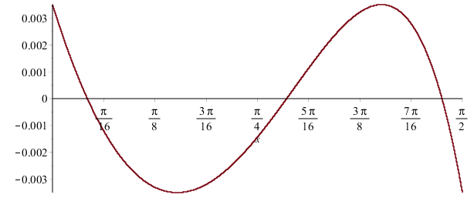
Additional note
If your goal is different, you can get different functions:
This minimizes the relative error on the interval [0, π/2] to less than 0.35%
It will never be more than 0.35% different than the actual value

Slide 32
Additional note
The implementation should reduce the number of necessary operations
double sin_min_rel_err( double x );
double sin_min_rel_err( double x ) {
return ((
-0.12982726700166469*x - 0.031041616418863258
)*x + 1.0034924244212799)*x;
}
Incidentally, the absolute error is less than 0.0033 on [0, π/2], so it’s also better than our first approximate with respect to absolute error…

Slide 33
Acknowledgments
Proof read by Dr. Thomas McConkey.

Slide 34



Colophon
These slides were prepared using the Georgia typeface. Mathematical equations use Times New Roman, and source code is presented using Consolas.
The photographs of lilacs in bloom appearing on the title slide and accenting the top of each other slide were taken at the Royal Botanical Gardens on May 27, 2018 by Douglas Wilhelm Harder. Please see
https://www.rbg.ca/
for more information.

Slide 35
Disclaimer
These slides are provided for the ece 150 Fundamentals of Programming course taught at the University of Waterloo. The material in it reflects the authors’ best judgment in light of the information available to them at the time of preparation. Any reliance on these course slides by any party for any other purpose are the responsibility of such parties. The authors accept no responsibility for damages, if any, suffered by any party as a result of decisions made or actions based on these course slides for any other purpose than that for which it was intended.

